Slide 1
Pizza Sales Data Analysis
Insights from Order Data
Presented by: AKANKSHA KUMARI

Slide 2
Agenda
Introduction
Sum
Total revenue
Average Order Value Total pizza sold
Pizzas Made During Peak Periods
Best and Worst-Selling Pizzas
Seating Capacity Utilization
Conclusion

Slide 3
Introduction
Content:
This presentation explores key insights from the pizza order data.
Focus on identifying peak business periods, popular products, revenue patterns, and seating capacity utilization.

Slide 4
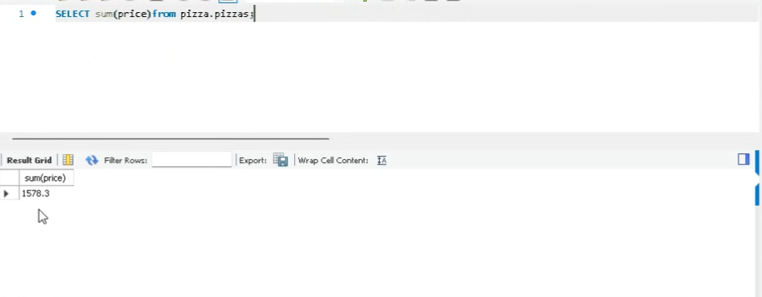

Slide 5
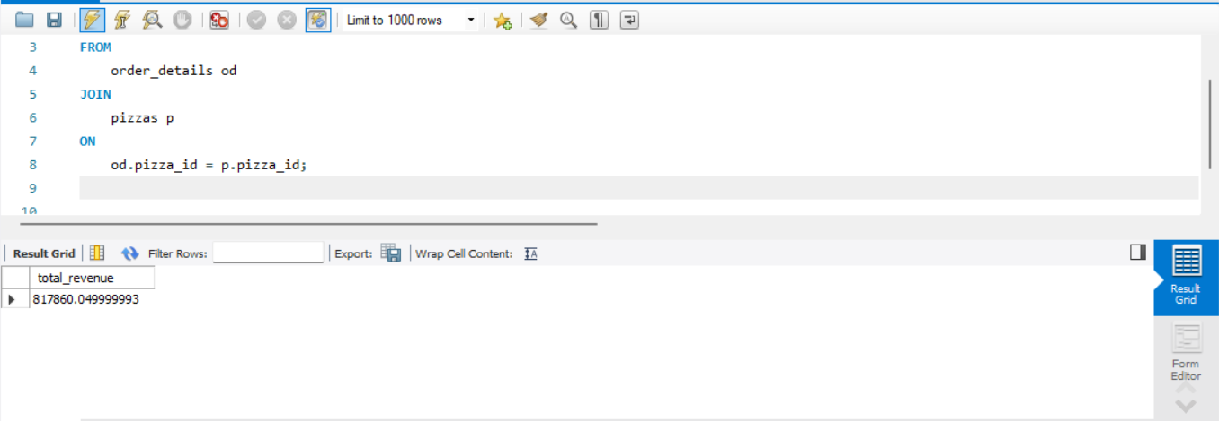

Slide 6
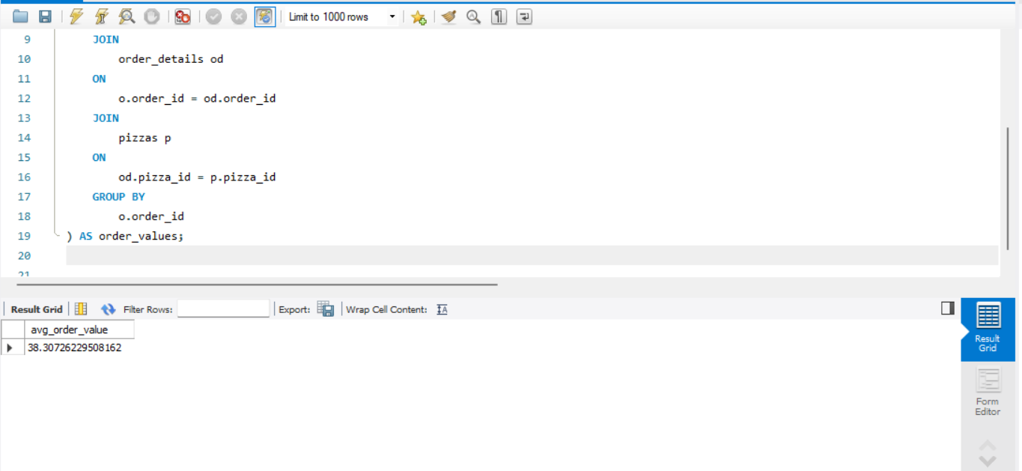

Slide 7
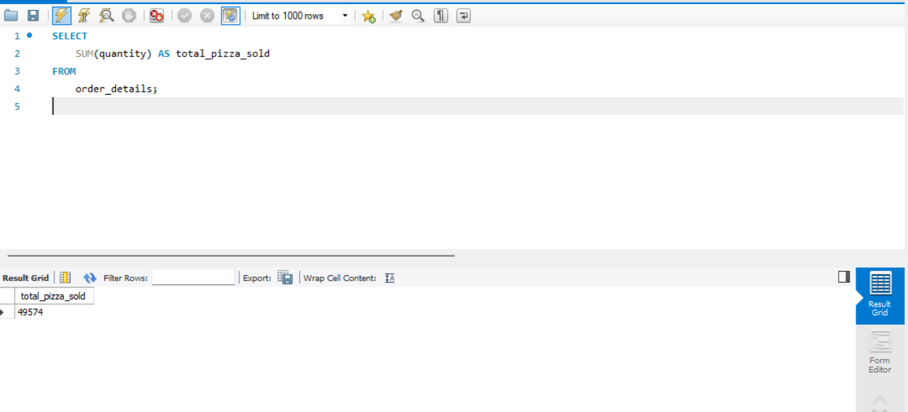

Slide 8
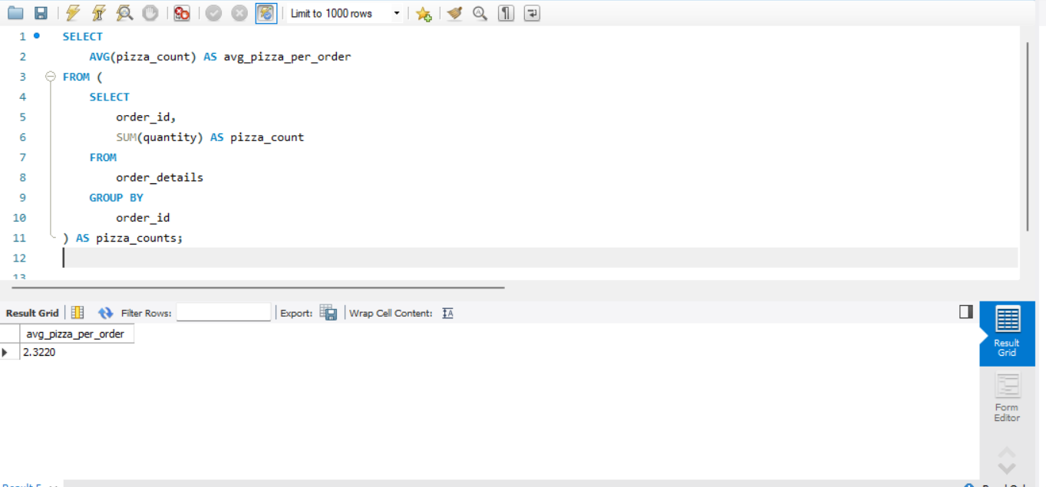

Slide 9
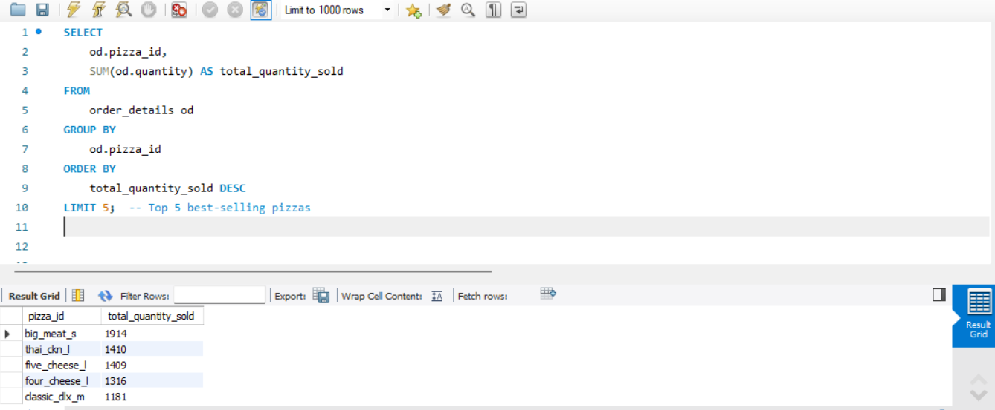

Slide 10


Slide 11
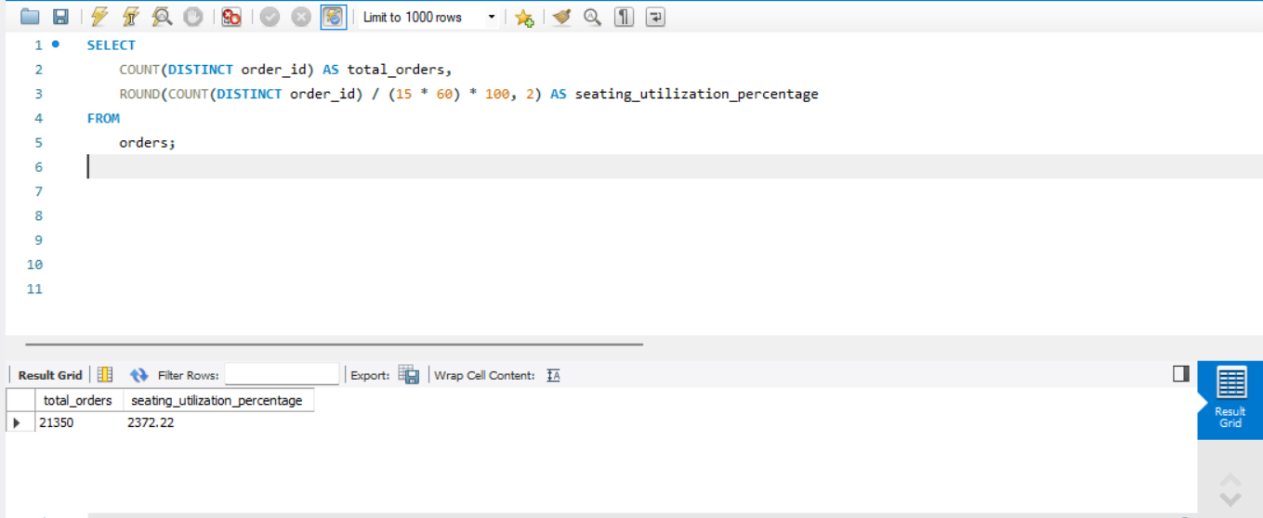

Slide 12
Conclusion: Insights from Pizza Sales Analysis
Busiest Times and Days:
Peak sales occur during weekends, especially evenings (6 PM - 9 PM).
Weekdays see moderate activity, with lunch hours (12 PM - 2 PM) being slightly busier.
Best-Selling Pizzas:
Popular pizzas include Margherita and Pepperoni across all sizes.
XX Large and Large sizes contribute significantly to revenue.
Least-Selling Pizzas:
Specialty pizzas with niche toppings have lower sales, indicating potential overstock or need for marketing efforts.
Revenue Insights:
Average order value is $X (derived from total revenue divided by total orders).
Promotions during off-peak hours could boost sales.
Seating Utilization:
Maximum seating capacity is reached during peak periods, but off-peak hours show significant underutilization (e.g., mornings and late afternoons).

